Slide 1
Machine Learning Model on
Rain Prediction
By Sidharth Khurana

Slide 2
Objective
Problem Statement:
Create a Machine Learning model using various Classification
Models to predict rainfall in Sydney.
Project is a classification problem that has the following input features:
Date
Location
Temperature(Min, Max, 9am, 3pm)
Rainfall
Evaporation
Sunshine
Humidity(9am, 3pm), Pressure(9am, 3pm), Cloud(9am, 3pm)
RainToday
Output Feature is RainTomorrow, which we have to predict.

Slide 3
Objective
Stakeholders:
Agriculture & Farmers
Planning irrigation, sowing, and harvesting schedules.
Reducing crop loss from unexpected rain.
Water Management Authorities
Reservoir and dam management.
Flood risk assessment and early warning systems.
Logistics & Transport Companies
Optimizing shipping and delivery schedules.
Preventing delays due to bad weather.
Insurance Companies
Crop or property insurance planning.
Estimating risk for weather-related claims.

Slide 4
Approach
Data Preparation:
Cleaned the data by dropping irrelevant columns, one-hot encoding categorical columns, and imputing the missing values with the mean.
Data is prepared for machine learning by splitting it into train and test data.

Slide 5
Approach
Train Baseline Model
Build a baseline classifier decision tree model to check for the performance.
Use bagging with classifier decision tree to improve performance.
Notes:
Bagging: "Bagging," short for Bootstrap Aggregating, is a machine learning ensemble method that improves model stability and accuracy by creating multiple models from random subsets of the training data and combining their predictions. The process involves bootstrapping (sampling with replacement) to create these subsets, training a base model on each subset, and then aggregating their outputs (e.g., through averaging for regression or majority vote for classification) to reduce variance and the risk of overfitting. A well-known example of a bagging algorithm is the Random Forest.

Slide 6
Approach
Further models and evaluation
Build random forest model and evaluate the same
Use Grid Search CV to identify the best hyperparameters for random forest
Inference based on the best parameters

Slide 7
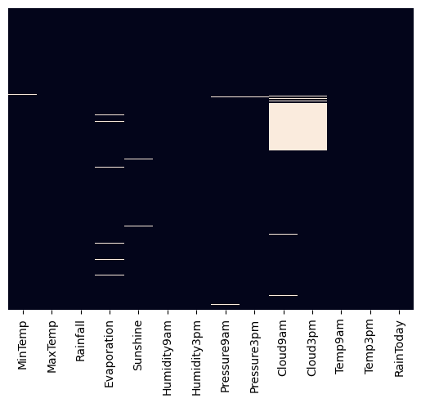
Model Summary
Datapoints
Heat Map for Null values
Description | Count
Data | 3,337
% Missing values | 16.9%
Train data | 2235
Test Data | 1102

Slide 8
Model Summary
Data Cleaning
Removed Date and Location columns
One-hot encoding of RainToday and RainTomorrow columns
Split data into X and y
Impute the missing values with mean

Slide 9
Model Summary
Models and metrics:
Models used:
Decision Tree
Random Forests
Metrics used:
Mean squared error
R2 score
Accuracy score

Slide 10
Model Summary
Parameters of Grid Search CV:
CV=5
Scoring: Accuracy
Details for Grid Search:
Model name: Random Forest
Max_features: [4,5,6,7,8,9,10]
Min_samples_split: [2,3,10]
Notes:
The cv parameter tells GridSearchCV how to split the data for evaluation. With cv=5, the following process is repeated for every combination of hyperparameters:
The dataset is divided into five equal-sized "folds" or subsets.
The model is trained on four of these folds, which are combined to form the training set.
The trained model's performance is then evaluated on the single remaining fold, which serves as the validation set.
This process is repeated five times, with each of the five folds serving as the validation set exactly once.
The scores from each of the five validation runs are averaged to get a single, more reliable performance metric for that specific hyperparameter combination.
max features: This parameter controls the maximum number of features (columns) that the model considers for the best possible split when building an individual decision tree. It is particularly important for models like Random Forest, which is an ensemble of many decision trees.
min samples split: This parameter controls the minimum number of samples required to split an internal node in a decision tree.

Slide 11
Results(Baseline Model)
Classification Tree:
Model Performance:
Mean Squared Error = 0.194 (test data)
Accuracy score = 0.828 (train data)
Accuracy score = 0.806 (test data)

Slide 12
Results(with Bagging)
Classification Tree + Bagging
Model Performance:
Accuracy score = 1.0 (train)
Accuracy score = 0.831 (test)

Slide 13
Results(Random Forest)
Model Performance:
Accuracy score = 1.0 (train)
Accuracy score = 0.823 (test)

Slide 14
Results(RF+Grid Search CV)
Model Performance:
Accuracy Score = 1.0 (train)
Accuracy Score = 0.8357 (test)

Slide 15
Reference
Code link:
https://github.com/oxerz8/IIT-Roorkee-Capstone-Project-Sydney-Rain-Prediction
Dataset link:
https://www.kaggle.com/datasets/jsphyg/weather-dataset-rattle-package

